Slide 1
CUSTOMER SEGMENTATION
Prepared By: R. Prasanth Kumar Reddy
Tools Used: Power BI | SQL | Excel | Power Query | DAX
Project Objective: Analyze customer purchasing behavior based on demographics, product categories, shopping malls, payment methods, and age groups to identify customer segments and generate actionable business insights.
Project Type: Data Analytics Portfolio project
Date: July 2026

Slide 2
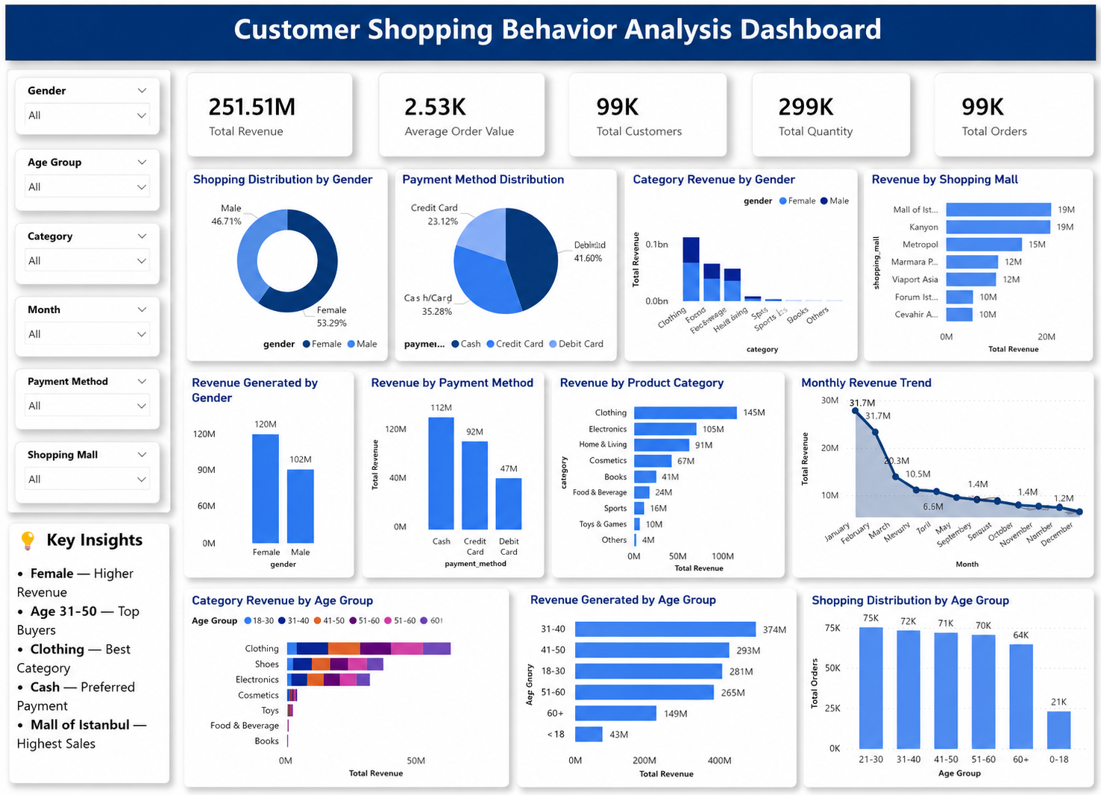

Slide 3
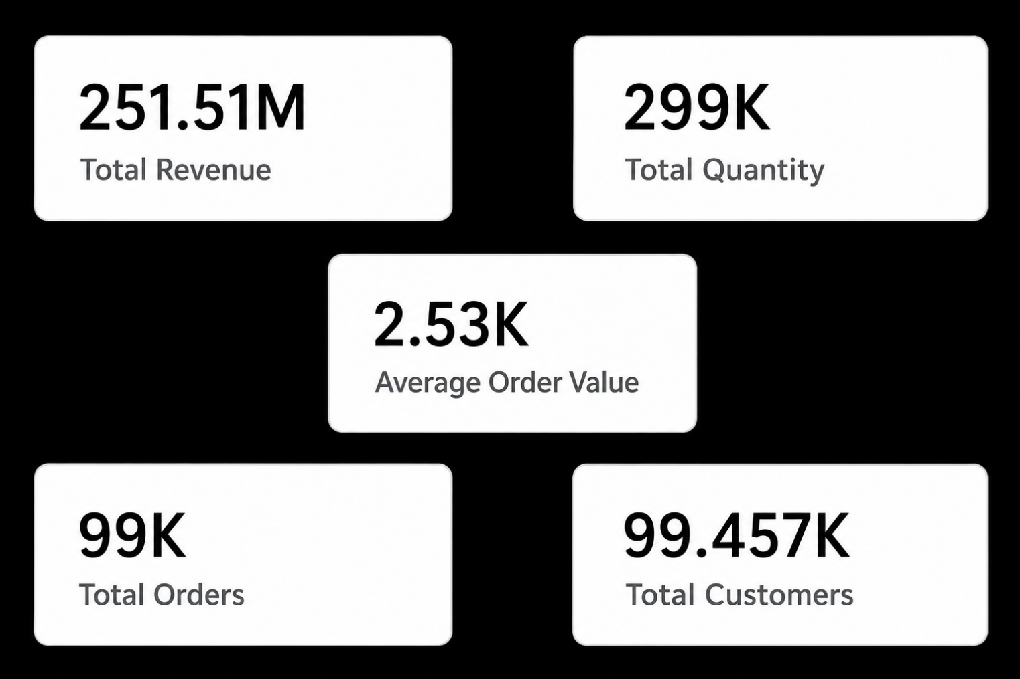

Key Performance Indicators (KPIs)
Total Revenue (251.51M): The business generated a total revenue of 251.51M, indicating strong overall sales performance.
Total Orders (99K): Approximately 99,000 orders were successfully completed during the analysis period.
Total Quantity (299K): A total of 299,000 products were sold, reflecting high customer demand.
Average Order Value (2.53K): Customers spent an average of 2.53K per order, showing healthy purchasing behavior.
Total Customers (99.457K): The business served nearly 99.5K unique customers, demonstrating a broad customer base.
Overall, the business achieved strong performance with 251.51M revenue, 99K orders, 299K products sold, an average order value of 2.53K, and nearly 100K customers.

Slide 4
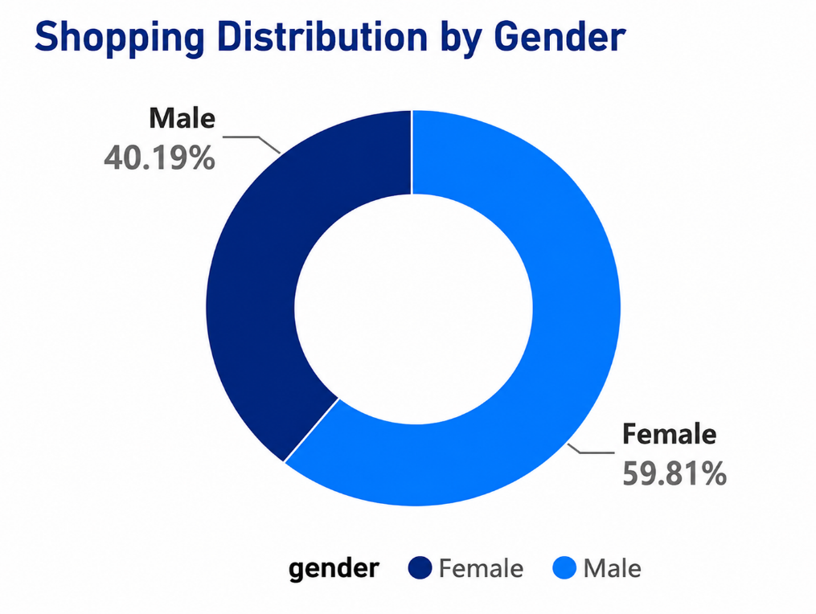
Shopping Distribution by Gender
*Female customers account for 59.81% of total purchases.
*Male customers contribute40.19%.
*Female shoppers are the dominant customer segment.
*Marketing campaigns should prioritize female customer preferences.

Slide 5
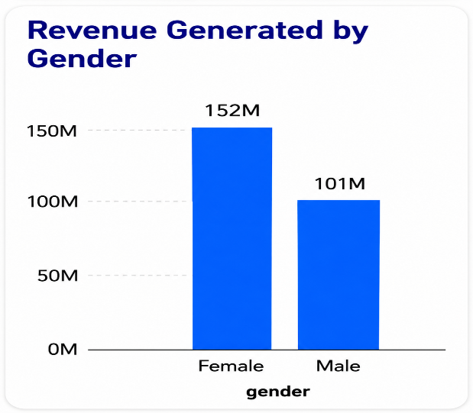
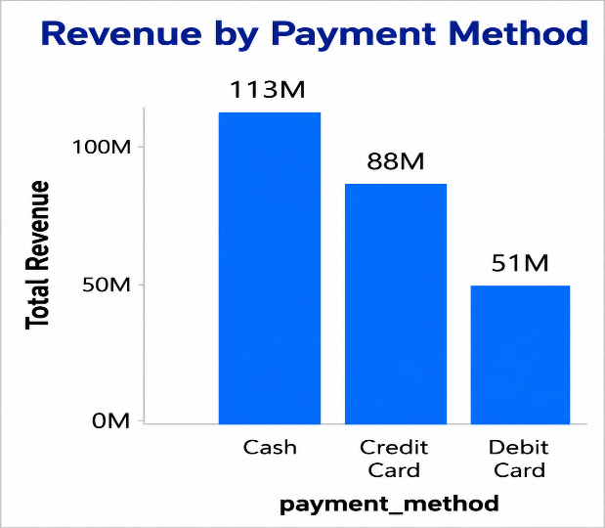
Revenue Contribution Analysis
*Female customers generated the highest revenue (~150M), outperforming male customers (~100M), making them the primary revenue contributors.
*Cash is the most revenue-generating payment method (~110M), followed by Credit Card (~90M), while Debit Card contributes the least (~50M).
*The business relies heavily on female shoppers and cash transactions for overall revenue generation.
*Increasing digital payment adoption through card offers and loyalty rewards presents an opportunity to boost card-based revenue.

Slide 6
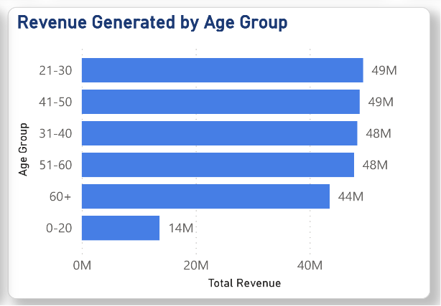
Revenue Contribution by Gender and Payment Method
Gender revenue summary: Female customers contribute significantly more revenue than male customers, indicating they are the primary revenue-driving customer segment.
Highest revenue contributor (Gender): Female customers generated approximately 150M in revenue, outperforming male customers by a substantial margin.
Payment method performance: Cash is the leading payment method in terms of revenue, followed by Credit Card, while Debit Card contributes the least.
Business implication: Revenue is largely driven by female shoppers and cash transactions, suggesting opportunities to strengthen customer engagement and encourage greater adoption of digital payment methods through targeted offers and rewards.

Slide 7
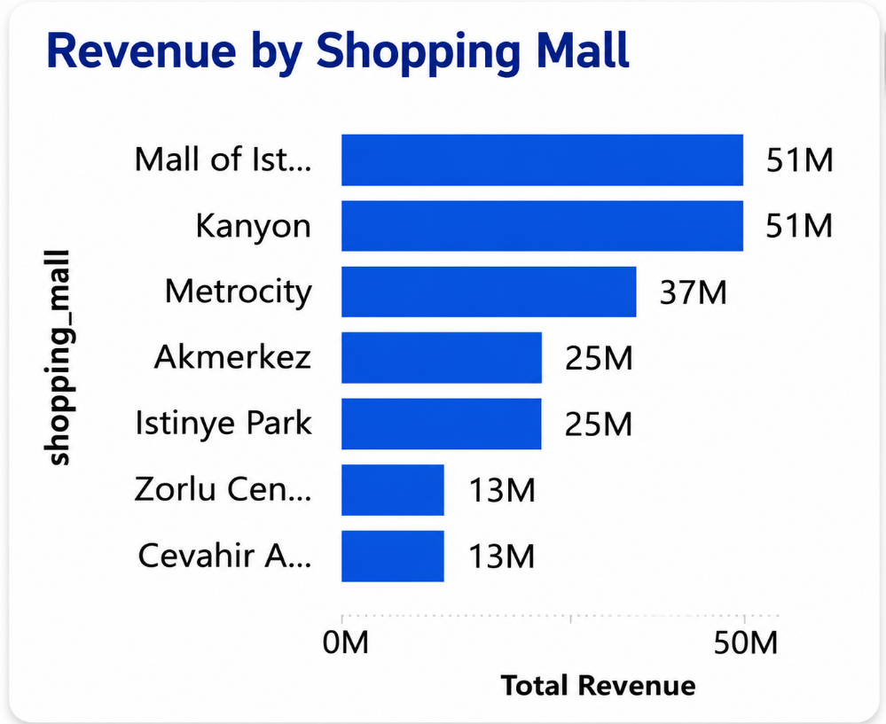
Shopping Mall Revenue Analysis
Revenue distribution: Revenue is concentrated among a few top-performing shopping malls, while the remaining malls contribute comparatively lower sales.
Highest revenue-generating mall: Mall of Istanbul generated the highest revenue (approximately 50M), making it the strongest-performing shopping location.
Lowest revenue-generating malls: Emaar Square Mall and Forum Istanbul recorded the lowest revenue, indicating lower customer spending or footfall.
Business implication: The top-performing malls should be prioritized for inventory expansion and marketing campaigns, while lower-performing malls may require targeted promotions and customer engagement strategies to improve sales.

Slide 8
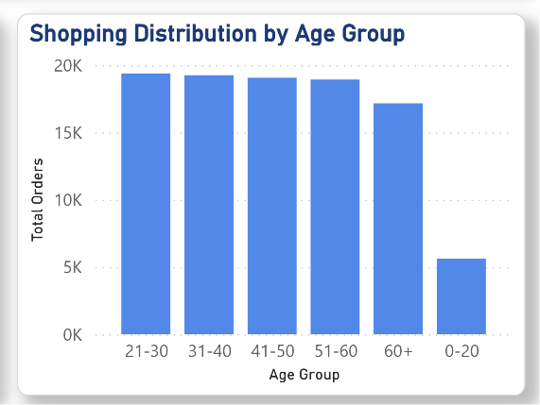
Shopping Distribution by Age Group
Shopping distribution: Customers aged 26–65 account for the majority of product purchases, indicating that middle-aged customers are the most active shoppers.
Highest shopping age group: The 36–45, 26–35, 46–55, and 56–65 age groups record the highest purchase volumes, each contributing significantly to total products sold.
Lowest shopping age group: The Under 18 age group has the fewest purchases, followed by customers aged 65+, reflecting lower shopping activity.
Business implication: Marketing strategies should continue focusing on the 26–65 age segment while introducing targeted campaigns and promotions to increase engagement among younger and senior customers.

Slide 9
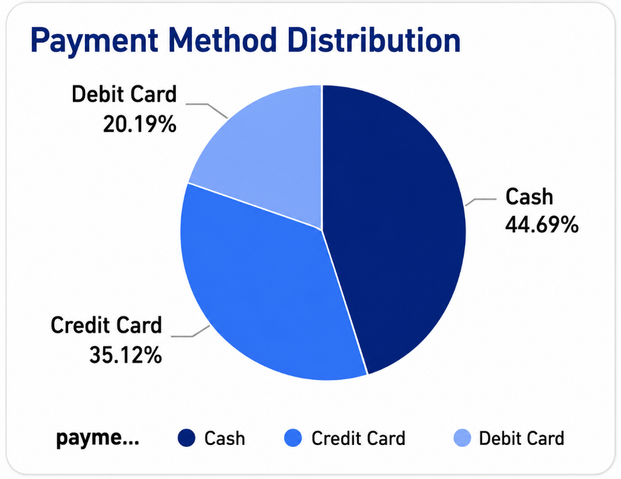
Payment Method Distribution
Payment method preference: Customers predominantly prefer Cash for their purchases, followed by Credit Card, while Debit Card is the least used payment method.
Most preferred payment method: Cash accounts for the highest share of transactions (44.69%), highlighting its popularity among customers.
Least preferred payment method: Debit Card represents the smallest share of transactions (20.19%), indicating lower customer adoption.
Business implication: While cash remains the dominant payment method, encouraging digital payments through cashback offers, discounts, and loyalty rewards can increase Credit Card and Debit Card usage while improving transaction efficiency.

Slide 10
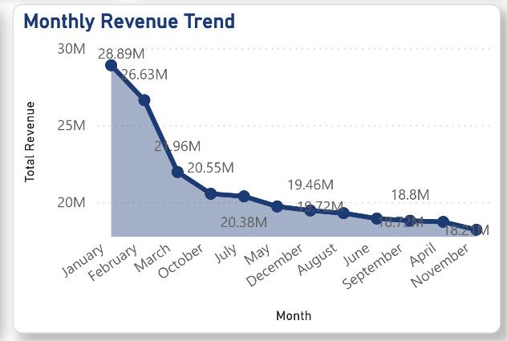
Monthly Revenue Trend
Revenue trend: Revenue starts at its highest level in January, declines during the first half of the year, and remains relatively stable with minor fluctuations thereafter.
Peak revenue month: January records the highest monthly revenue, indicating strong customer spending at the beginning of the year.
Lowest revenue month: November shows the lowest revenue, reflecting a temporary slowdown in sales performance.
Business implication: The business experiences seasonal variations in revenue. Analyzing the factors behind January's strong performance and implementing targeted promotions during lower-performing months can help maintain consistent revenue throughout the year.

Slide 11
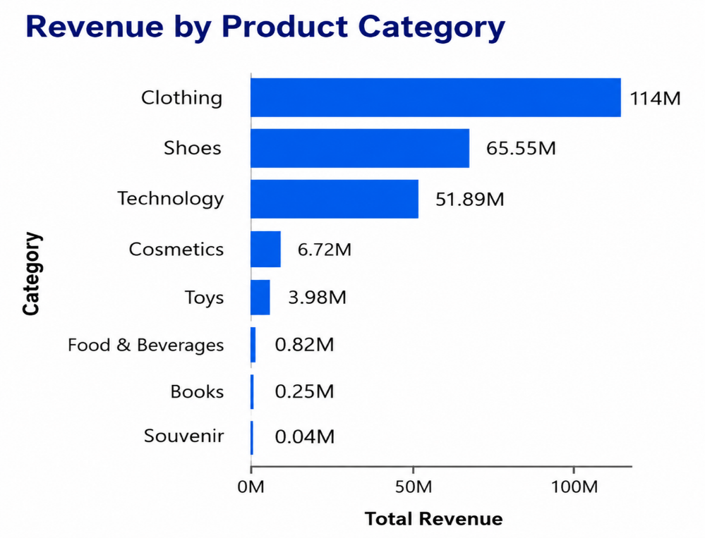
Revenue by Product Category
Category performance: Revenue is heavily concentrated in a few product categories, with Clothing, Shoes, and Technology contributing the majority of total sales.
Highest revenue-generating category: Clothing is the top-performing category, generating the highest revenue and serving as the primary driver of business sales.
Lowest revenue-generating category: Books and Souvenirs contribute the least revenue, indicating comparatively lower customer demand.
Business implication: Maintaining strong inventory and promotional efforts for high-performing categories while introducing targeted marketing campaigns for low-performing categories can help maximize overall revenue and improve category performance

Slide 12
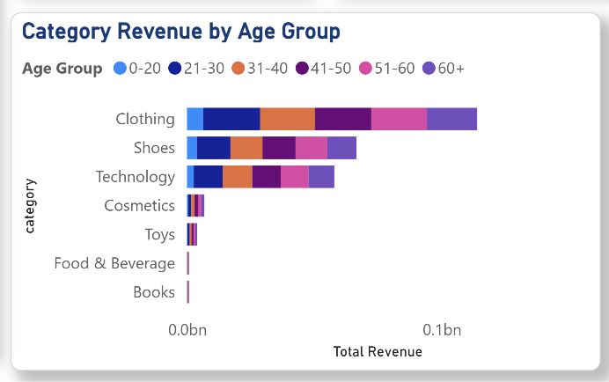
Revenue by Product Category and Age Group
Revenue distribution: Customers aged 26–65 generate the majority of revenue across all product categories, making them the most valuable customer segment.
Highest revenue contributor: Clothing is the highest revenue-generating category across nearly every age group, with the strongest contribution coming from customers aged 36–45 and 46–55.
Lowest revenue contributor: Books and Souvenirs generate the least revenue across all age groups, with minimal contribution from Under 18 customers.
Business implication: The business should continue focusing on high-performing categories such as Clothing, Shoes, and Technology for the 26–65 age segment, while introducing targeted promotions to improve sales among younger customers and in lower-performing product categories.

Slide 13
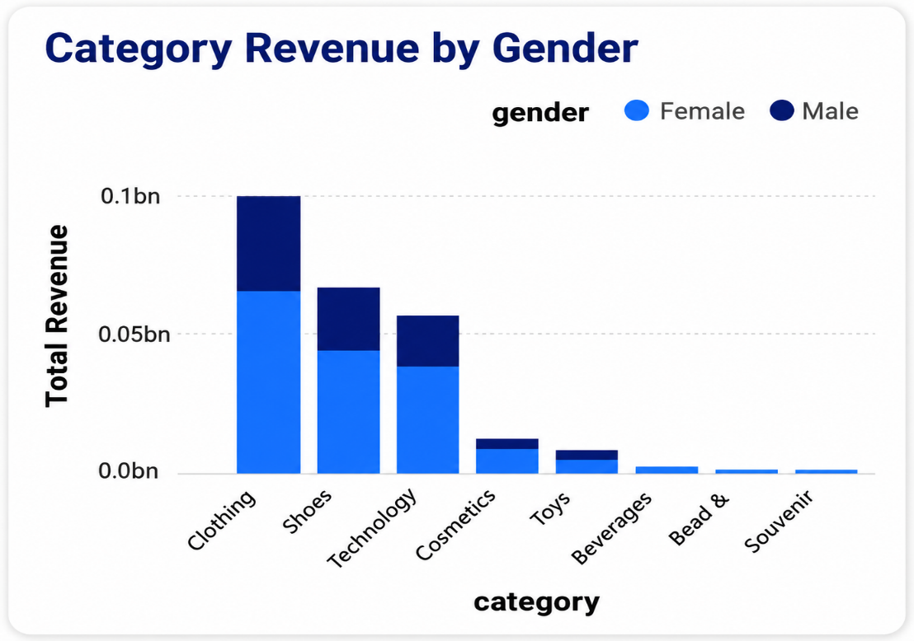
Revenue by Product Category and Gender
Revenue distribution: Female customers generate higher revenue than male customers across most product categories, making them the primary contributors to overall sales.
Highest revenue contributor: Clothing is the highest revenue-generating category for both genders, with female customers contributing the largest share.
Lowest revenue contributor: Books and Souvenirs generate the lowest revenue for both male and female customers, indicating relatively lower demand.
Business implication: The business should continue focusing on high-performing categories such as Clothing, Shoes, and Technology, while implementing targeted marketing strategies to boost sales in lower-performing categories and strengthen engagement across both customer segments.

Slide 14
Conclusion
This customer segmentation analysis reveals key insights into customer purchasing behavior across demographics, product categories, payment methods, and shopping malls. Female customers and the 26–65 age group contribute the highest revenue, while Clothing, Shoes, and Technology are the top-performing product categories.
The findings support data-driven business decisions by identifying valuable customer segments and sales trends. These insights can help improve marketing strategies, optimize inventory, enhance customer engagement, and drive overall business growth.

Slide 15
THANK YOU …!
&
Questions?

